Slide 1
1.Write a program to move the content of memory location 0500H to register BX and also to CX . Add immediate byte 05H to the data residing in memory location whose address is computed using DS = 2000 and offset = 0600H. Store the result of the addition in 0700H. Assume that the data is located in the segment specified by data segment register DS which contain 2000H.
SOLN:
MOV AX , 2000H
MOV DS, AX initialize data segment
MOV BX ,[O500H] get content of 0500H in BX
MOV CX,BX copy contents in CX
ADD [0600H],05H add 05H to content of 0600H
MOV DX,[0600H]
MOV [0700H],DX
HLT

Slide 2
2.Write a program to add a data byte located at offset 0500H in 2000H segment to another data byte available at 0600H in the same segment

Slide 3
MOV AX, 2000H initialize DS
MOV DS,AX
MOV AX,[0500H] set first byte
ADD AX,[0600H] add second byte
MOV[0700H],AX store result
HLT

Slide 4
3.Write a program to move a string of data words from offset 2000H to offset 3000H. The length of string is 0FH. DS = 5000H

Slide 5
MOV AX,5000H
MOV DS,AX
MOV SI ,2000H
MOV DI,3000H
MOV CX,OFH
Again MOV AX,[SI]
MOV[DI],AX
INC SI
INC DI
DEC CX
JNZ again
HLT

Slide 6
DS= 5000/SEGMENT DS
ES= 6000/SEGMENT ES
Different method
MOV AX,5000H
MOV DS,AX
MOV AX,6000H
MOV ES,AX
MOV CX,OFFH
MOV SI,1000H
MOV DI,2000H
CLD
MOV SB
HLT

Slide 7
Use of REP and SCASW
MOV AX,SEG
MOV ES,AX
MOV DI,OFFSET
MOV CX,10
MOV AX,WORD
CLD
REPNE SCASW
(scan 10 bytes till a match is found)

Slide 8
REP AND MOVSB
MOV AX,5000 initialize DS
MOV DS,AX
MOV AX,6000H initialize DS
MOV ES,AX
MOV CX,00FF initialize COUNTER
MOV SI,1000H load offset addr
MOV DI,2000H
CLD decide direction
REP MOVSB
(mov FF string bytes from source to destination )

Slide 9
REP , CMPSW
MOV AX,5000 initialize DS
MOV DS,AX
MOV AX,6000H initialize DS
MOV ES,AX
MOV CX,10 initialize COUNTER
MOV SI,1000H load offset addr
MOV DI,2000H
CLD decide direction
REPE CMPSW
(compare10 words of string 1 and 2 while they are equal )

Slide 10
4.Write aprogram to find out the largest number from given unordered array of 8 bit numbers the array starts at 0800H in segment DS with address 3000H. Store the result in 0900H offset.
Assume CS : COD E , DS : data segment
List DB 52H , 23H , 56H……….
COUNT EQU OF
Largest DB 01H
Data ends.

Slide 11
Code segment
START MOV AX,DATA
MOV DS,AX
MOV SI, offset list
MOV CL, count
MOV AL,[SI]
Again CMP AL,[SI+1]
JNL Next (JGE Jump if > or = or not less than)
MOV AL ,[SI+1]
Next INC SI
DEC CL
JNZ Again
MOV SI, offset largest
MOV[SI],AL
HLT
[ CMP = if both are egual ZF=1
Src>Dest CF= 1
Src<Dest CF= 0}

Slide 12
5. Using string instruction MOV SB and LOOP move a byte string 16 byte long from offset 0200H to 0300H in segment 7000H

Slide 13
MOV AX,7000H
MOV DS,AX
MOV ES,AX
MOV CX,0010H
BACK : MOV AX [SI]
MOV[DI],AX
INC SI
INC DI
DEC CX
JNZ back
HLT

Slide 14
USING LOOP INSTRUCTION
MOV AX,7000H
MOV DS,AX
MOV SI,0200H
MOV DI,0300H
MOV CX,0010H
Back: MOV AX,[SI]
MOV [DI],AX
INC SI
INC DI
LOOP BACK
HLT

Slide 15
USING MOVSB Instruction
MOV AX,7000H
MOV DS,AX
MOV ES,AX
MOV CX,0010H MOV SI, 0200H
MOV DI 0300H
MOV [DI],AX CLD
REP MOVSB
HLT

Slide 16
.
Write a program for addition of series of 8 bit numbers .The series contains 100 numbers
Assume CS: code , DS: data
Data segment
DB 52H, 23H ……………..
COUNT EQU 100D
Result DW 01
DATA ENDS

Slide 17
CODE SEGMENT
START MOV AX,DATA
MOV DS,AX
MOV CX, count
XOR AX,AX (CLEAR AX & CF)
XOR BX,BX
MOV SI , Offset numlist
Again MOV BL,[SI]
ADD AX, BX
INC SI
DEC CX
JNZ AGAIN
MOV DI , OFFSET RESULT
MOV [DI],AX
HLT

Slide 18
.Add the content of memory location 2000H : 0500 to content of 3000H : 0600H & store the result in
5000 H : 0700H

Slide 19
MOV CX , 2000H
MOV DS, CX
MOV AX, [0500]
MOV CX, 3000H
MOV DS, CX
MOV BX , [0600H]
ADD AX, BX
MOV CX, 5000H
MOV DS , CX
MOV [0700], AX
HLT

Slide 20
8. Program to find out even and odd numbers from a given series of 16 bit hexadecimal numbers
Assume cs: code DS : data
Data segment
List DW 2357 H , OA579 A
COUNT equ 006H
Data ends

Slide 21
Code segment
STARTS XOR BX , BX
XOR DX, DX
MOV DS , AX
MOV CL , COUNT
MOV SI, offset list
Again MOV AX , [SI]
ROR AX , 01
JC ODD
INC BX
JMP Next
ODD INC DX
NEXT ADD SI,02
DEC CL
JNZ AGAIN
HLT

Slide 22
9. WAP to find out the number of positive numbers and negative numbers from a series of signed numbers
CS: code segment DS: data segment
LIST DW 2579H, 0450H , 0009H, 0159H
COUNT EQU 05H
DATA ENDS

Slide 23
CODE SEGMENT
START: XOR BX, BX
XOR DX, DX
MOV AX , DATA
MOV DS, AX
MOV CL, COUNT
MOV SI, offset
AGAIN: MOV AX, [SI]
SHL AX, 01
JC NEG
INX BX
JMP NEXT
NEG: INC DX
NEXT: ADD SI,02
DEC CL
JNZ Again
HLT

Slide 24
10. WAP to arrange a given series of hex bytes in ascending order
CS: CODE SEGMENT DS : DATA SEGMENT
LIST DW 53H, 25H 19H 02H
COUNT EQU 04
DATA ENDS

Slide 25
CODE SEGMENT
START MOV AX,DATA
MOV DS,AX
MOV DX,COUNT-1
AGAIN 0 : MOV CX,DX
MOV SI offset list
AGAIN 1 : MOV AX,[SI]
CMP AX,[SI+2]
JL PR 1
XCHG[SI+2],AX
XCHG [SI],AX
PR 1 ADD SI,02
LOOP AGAIN 1
DEC DX
JNZ AGAIN 0
HLT

Slide 26
11. WAP to perform a one byte BCD addition
assume CS: code segment DS: data segment
opr 1 EQU 92 H
opr 2 EQU 52 H
RESULT DB 02 DUP(00)
DATA ENDS

Slide 27
START MOV AX ,DATA
MOV DS ,AX
MOV BL, OPRI
XOR AL ,AL
MOV AL, OPR2
ADD AL, BL
DAA
MOV RESULT AL
JNC ENDS
INC [RESULT+1]
HLT

Slide 28
WAP to decide whether parity is even or odd if parity is even set DL to 00 else set DL to 01.The given number - DD 335A379B4 (Multi byte number)

Slide 29
MOV AX, DATA
MOV DS, AX
MOV DH, BYTE COUNT
XOR AL ,AL
MOV CL, 00
MOV SI , OFFSET NO
NEXT BYTE: ADD AL, [SI]
JP EVENP
INC CL
EVENP : INC SI
MOV AL,00
DEC DH
JNZ NEXT_BYTE
MOV DL,00
RCR CL,1
JNC clear
JNC DL
CLEAR: HLT

Slide 30
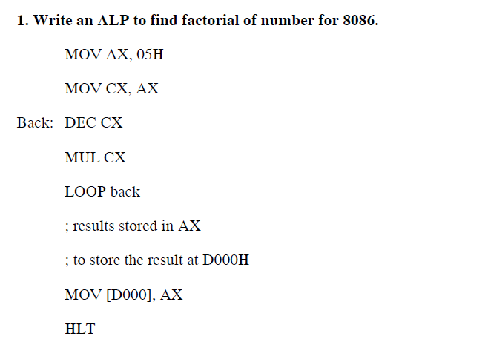

Slide 31
